Slide 1
Inheritance
COP 3003 Programming II (OOP)

Slide 2
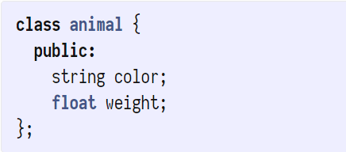
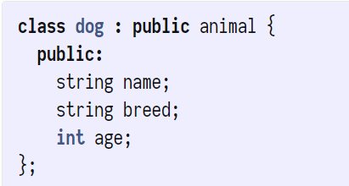
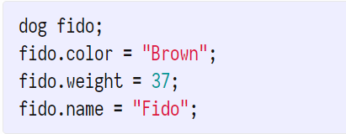
Inheritance
animal “has-a” color and weight
dog “is-a” animal
“public” animal – means that dog does not hide anything that animal declares public
dog “has-a” name, breed, and age, and inherits color and weight from animal

Slide 3
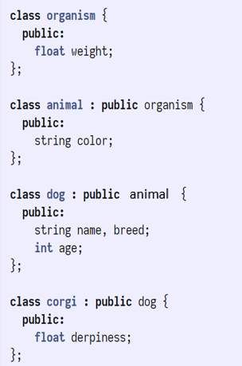
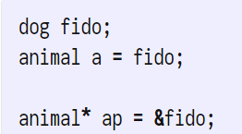

Slicing
Variable “a” is a copy of “fido”
Lose name, breed, and age
a. can only see weight and color
Pointer “ap” points to fido
Fido still has name, breed, and age
ap-> can only see weight and color
Function “breed” will receive “pure” animals, any dog or higher properties and methods will be removed (pass-by-value)

Slide 4
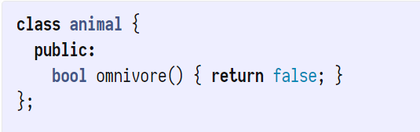
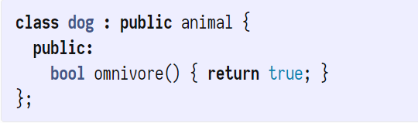
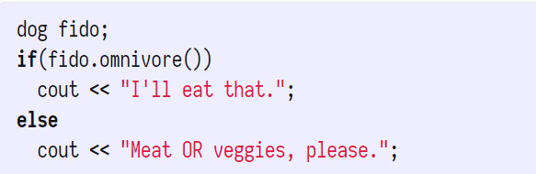
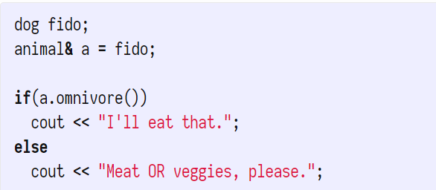
Overriding methods
Prints “I’ll eat that.”
Prints “Meat OR veggies, please.”
Why?
Normal Method uses animal::omnivore to determine action
1.
2.
Same as:
animal *a = &fido;

Slide 5
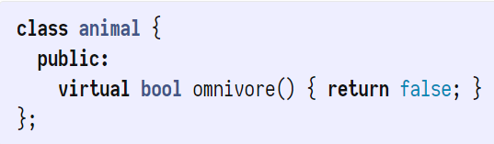


Virtual methods
Virtual methods are redefined by subclasses
a.omnivore() returns “true”
Virtual methods uses type of object pointed to by pointers to determine action
Use virtual when:
Intend to subclass a class
Intend to override behavior of base class methods
Note: non-pointer variables still perform slicing

Slide 6
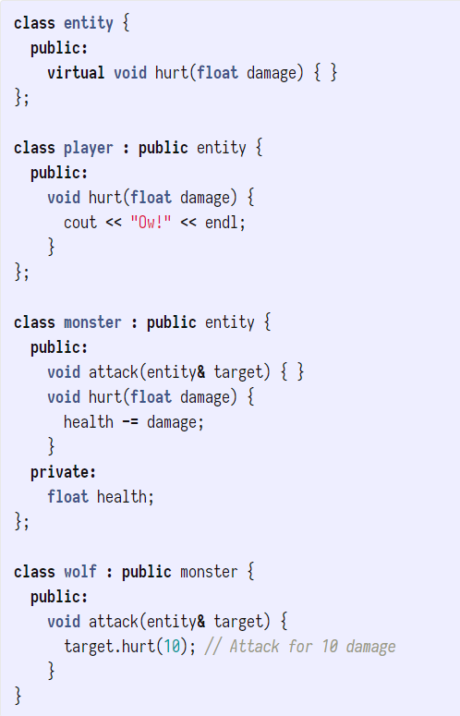
Polymorphism
Player is an entity
Wolf is a monster, and monster is an entity
Players can get hurt
Wolves are monsters and can attack any kind of entity (passed as a pointer)

Slide 7
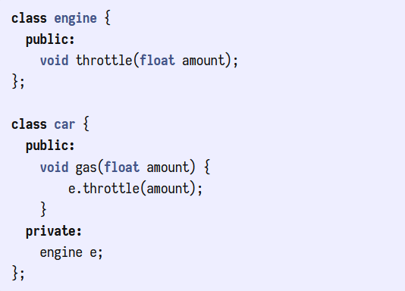
Composition
A car “has-a” engine
Use engine to call throttle

Slide 8
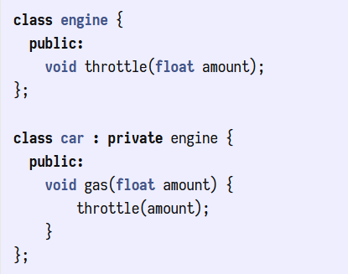

Composition through private inheritance
A car “brings-in” an engine
Throttle method of engine can be called directly by car
Note: we can’t call the throttle method outside of the car class methods like gas
Private members give more flexibility than private inheritance

Slide 9
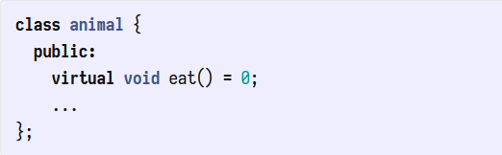

Abstract base classes <Interface>
“eat” is a “pure virtual” method
A class with only pure virtual methods is an abstract class or interface
You cannot create an object of an abstract class
An interface only describes what the base class looks like

Slide 10
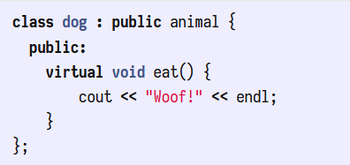


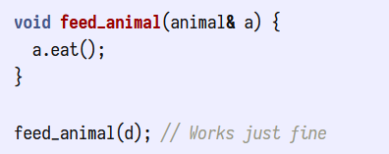
Implementing an <Interface>
Subclasses of an abstract class must override all pure virtual methods
Overriding eat makes dog a concrete class of animal
We can define a pointer of the base class to an object of a subclass
We can write functions that take a reference to an type of animal

Slide 11
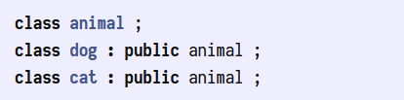
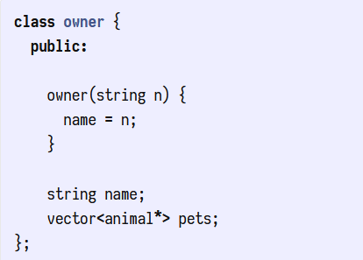
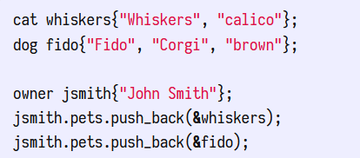
Inheritance for abstraction
Class owner can contain any combination of pets

Slide 12
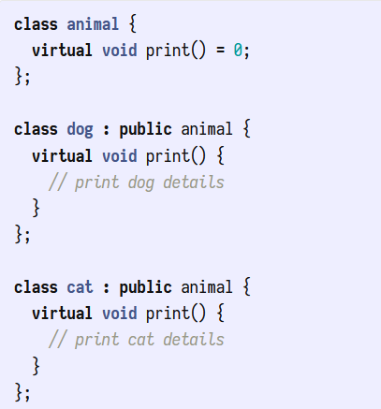
Abstracting methods
Animal is an abstract class with only pure virtual method print (an interface)
Each subclass must override print
With we can call print on any type of animal subclass and get its overridden behavior

